Slide 1
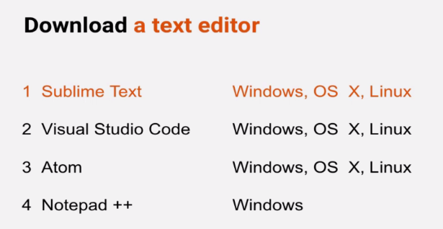
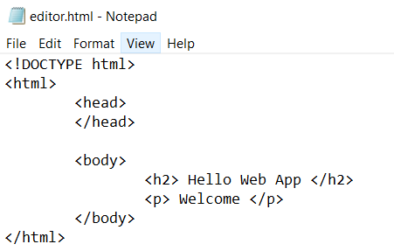
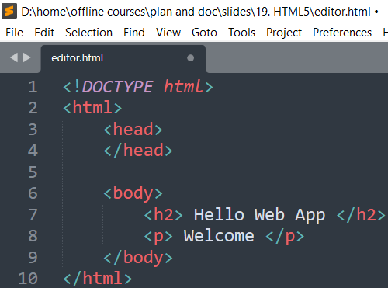
Download: https://www.sublimetext.com/3
HTML5 - 1. Setting Up Front-End Developer Environment
https://www.techartvn.com/academy

Slide 2
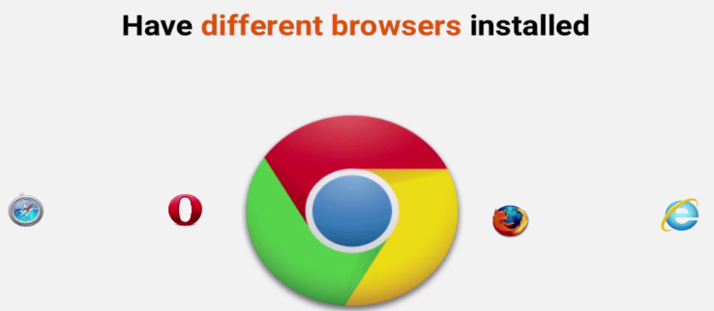
Download: https://www.google.com/chrome/
HTML5 - 1. Setting Up Front-End Developer Environment
https://www.techartvn.com/academy
Notes:
Web Page, Web Browser → Web Server

Slide 3
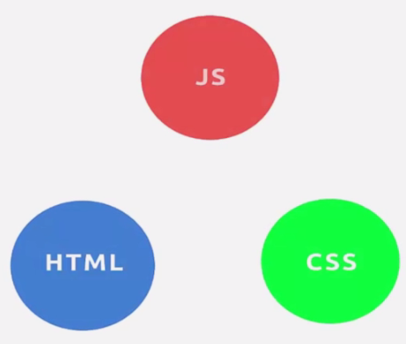
Download: https://www.google.com/chrome/
HTML5 - 2. Webpage Structure
https://www.techartvn.com/academy

Slide 4

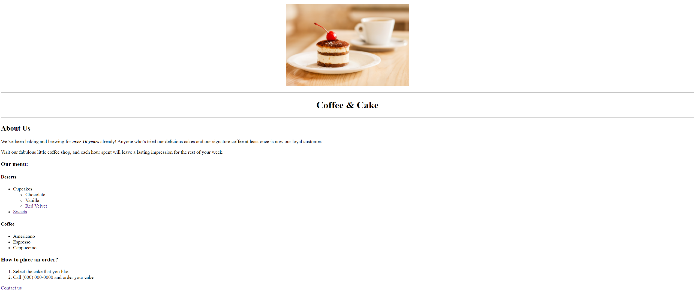
Download: https://www.google.com/chrome/
HTML5 - 2. Webpage Structure
https://www.techartvn.com/academy
Notes:
It’s a tag tell browser how to display

Slide 5
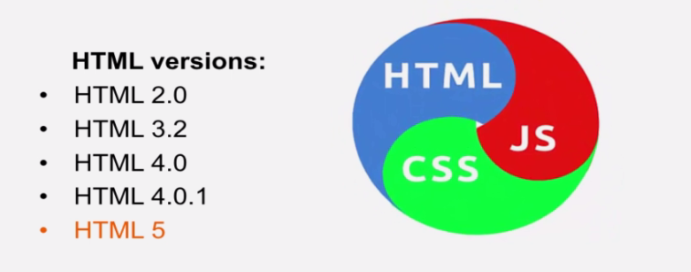
Download: https://www.google.com/chrome/
HTML5 - 2. Webpage Structure
https://www.techartvn.com/academy
Notes:
It’s a tag tell browser how to display

Slide 6
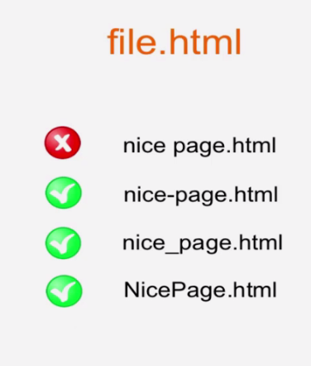
Open Sublime Text
File – new file – site >> index.html
File – save
HTML5 - 3. Your First Webpage
https://www.techartvn.com/academy

Slide 7
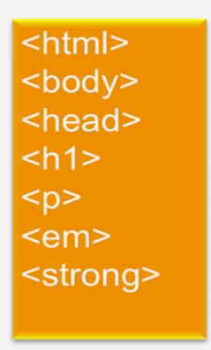

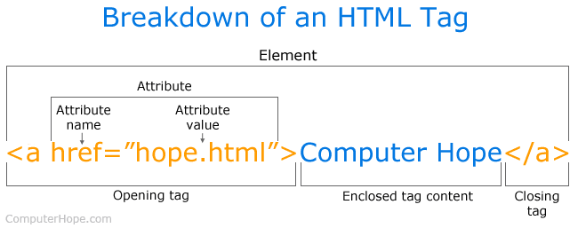
Download: https://www.google.com/chrome/
HTML5 - 2. Webpage Structure
https://www.techartvn.com/academy
Notes:
<tag> is a base of HTML

Slide 8
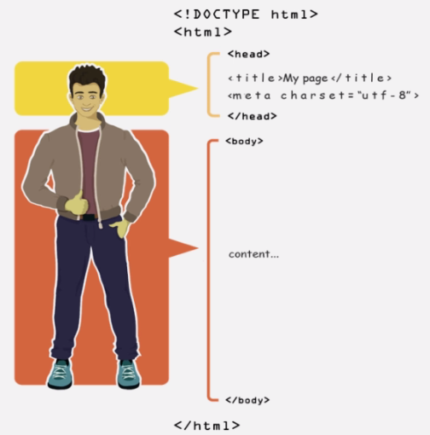
Ref : https://www.apple.com/
Ref: https://www.ebay.com/
View Page Source
HTML5 - 2. Webpage Structure
https://www.techartvn.com/academy

Slide 9
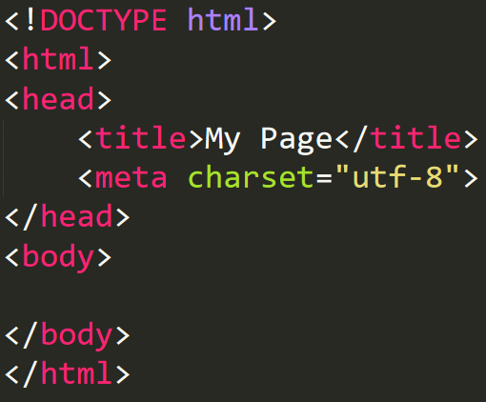
Open Sublime Text
File – new file – site >> index.html
File – save
Right click – Open in web browser
Double click – index.html
HTML5 - 3. Your First Webpage
https://www.techartvn.com/academy

Slide 10

Open Sublime Text
File – new file – site >> index.html
File – save
Right click – Open in web browser
Double click – index.html
HTML5 - 4. Headings
https://www.techartvn.com/academy

Slide 11
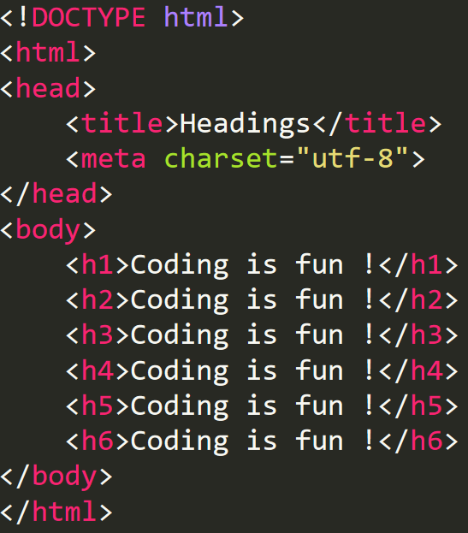
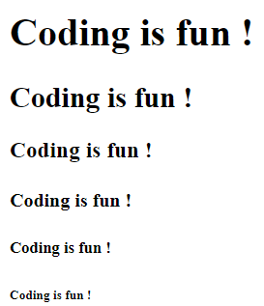
Open Sublime Text
File – new file – site >> index.html
File – save
Right click – Open in web browser
Double click – index.html
HTML5 - 4. Headings
https://www.techartvn.com/academy

Slide 12
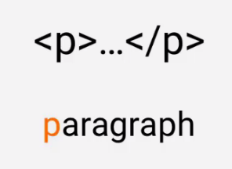
Open Sublime Text
File – new file – site >> index.html
File – save
Right click – Open in web browser
Double click – index.html
HTML5 - 5. Paragraph
https://www.techartvn.com/academy

Slide 13

Ref: https://en.wikipedia.org/wiki/Lemonade
Cannot change html look with add extra empty lines, spaces
Using pre tag – preformatted tag
HTML5 - 5. Paragraph
https://www.techartvn.com/academy

Slide 14

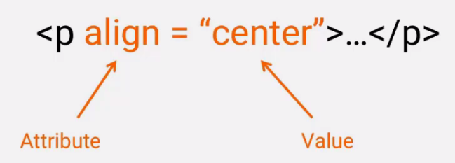
HTML5 - 6. Formatting Text
https://www.techartvn.com/academy

Slide 15
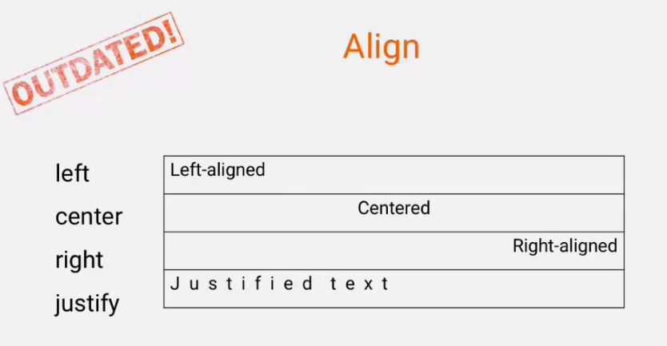
HTML5 - 6. Formatting Text
https://www.techartvn.com/academy

Slide 16

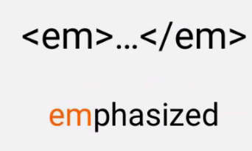
HTML5 - 6. Formatting Text
https://www.techartvn.com/academy

Slide 17
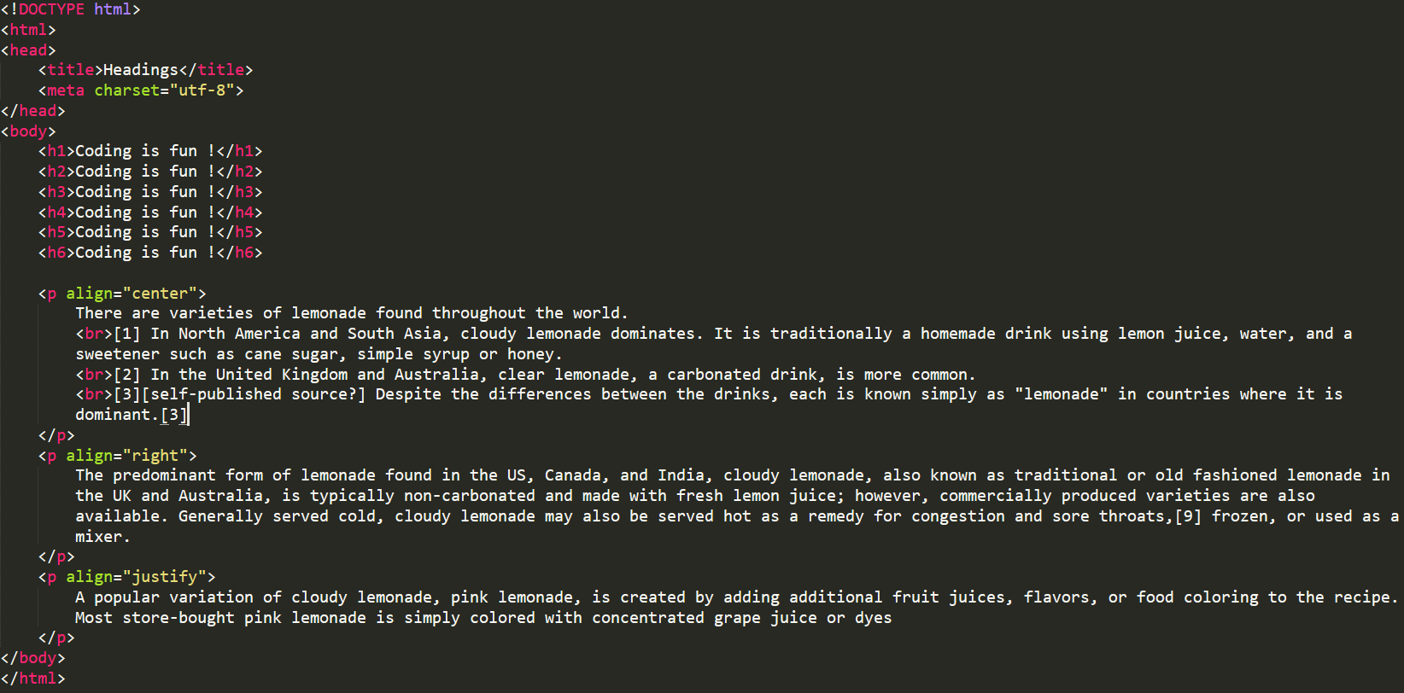
HTML5 - 6. Formatting Text
https://www.techartvn.com/academy

Slide 18
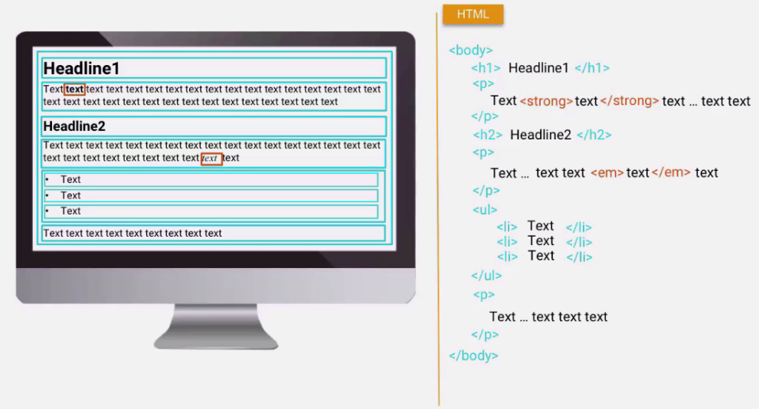
HTML5 – 19. Inline Block Elements
https://www.techartvn.com/academy

Slide 19
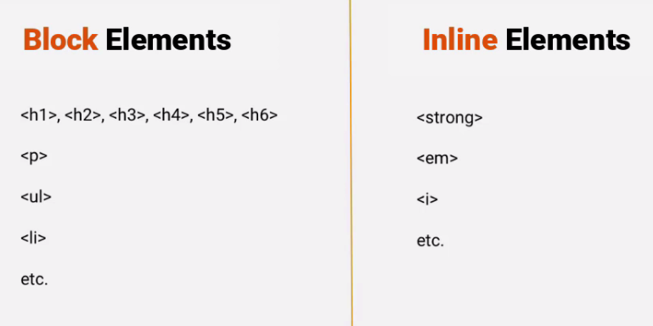
Details: https://www.w3schools.com/html/html_blocks.asp
HTML5 – 19. Block Inline Elements
https://www.techartvn.com/academy

Slide 20
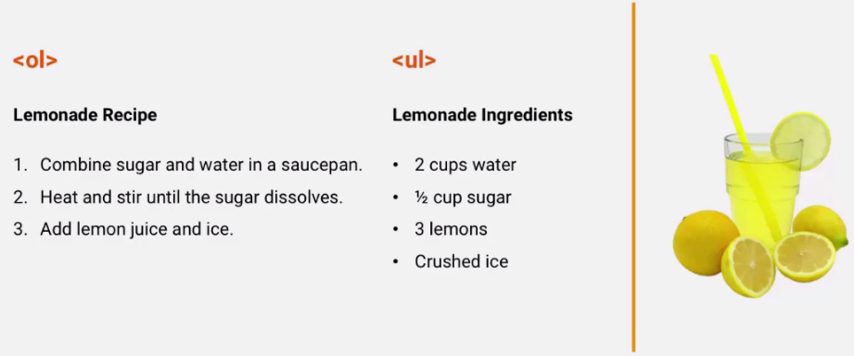
HTML5 - 7. Ordered/Unordered Lists
https://www.techartvn.com/academy

Slide 21
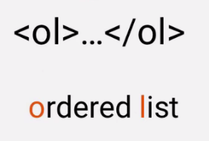
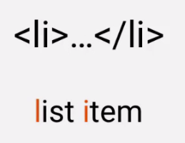
HTML5 - 7. Ordered Lists
https://www.techartvn.com/academy

Slide 22
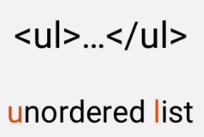
HTML5 - 8. Unordered Lists
https://www.techartvn.com/academy

Slide 23
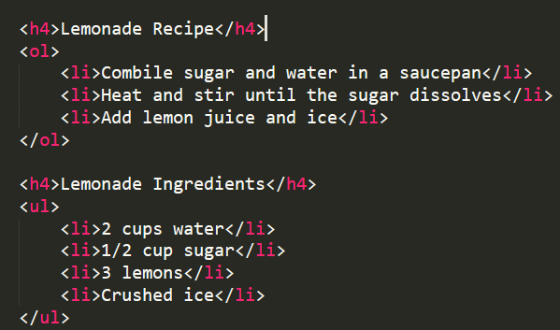
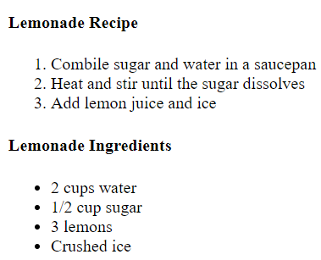
Use list-style attribute to change bullet
Ref: https://www.w3schools.com/css/css_list.asp
HTML5 - 8. Unordered Lists
https://www.techartvn.com/academy

Slide 24
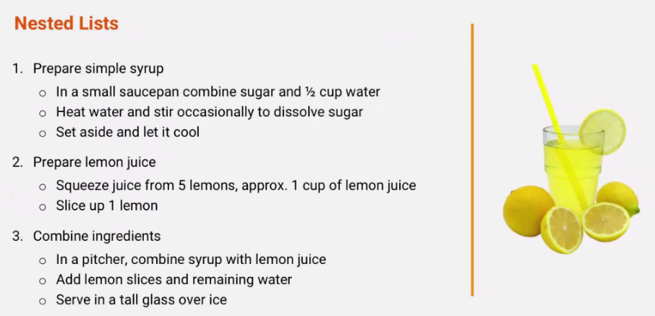
HTML5 - 9. Nested Lists
https://www.techartvn.com/academy

Slide 25
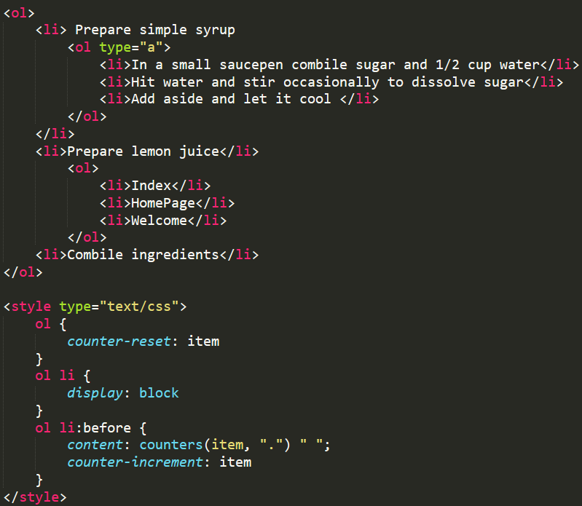
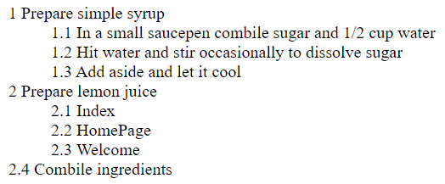
HTML5 - 9. Nested Lists
https://www.techartvn.com/academy

Slide 26

HTML5 - 10. Image
https://www.techartvn.com/academy

Slide 27
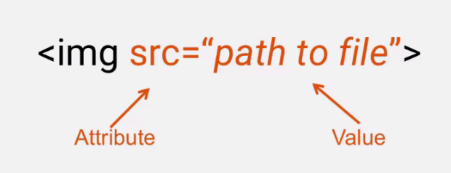
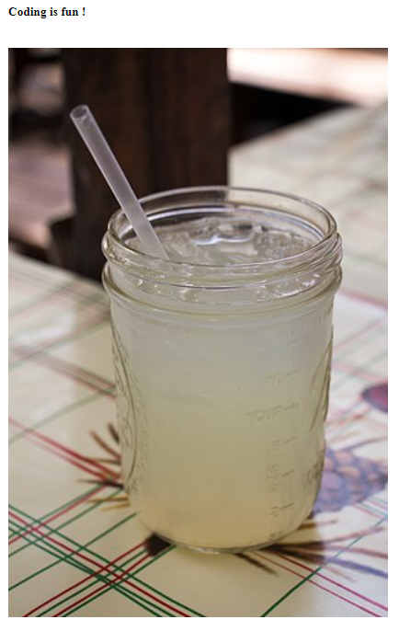
Right click – Copy Image Address
Right click – Save Image As
HTML5 - 10. Image
https://www.techartvn.com/academy

Slide 28
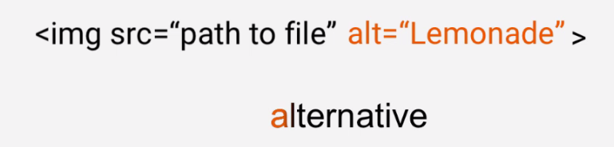
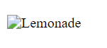
Right click – Copy Image Address
Right click – Save Image As
Show alt text in case not found image path
HTML5 - 10. Image
https://www.techartvn.com/academy

Slide 29
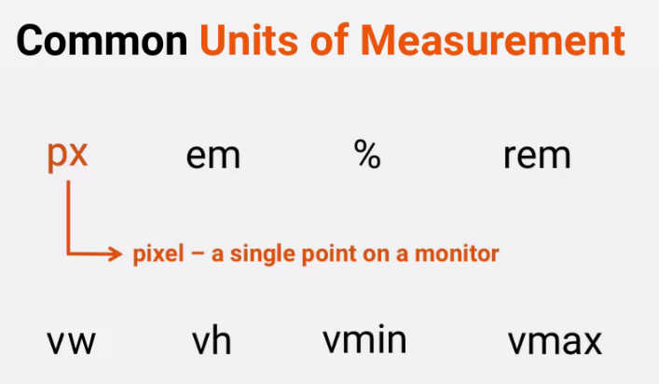
Right click – Copy Image Address
Right click – Save Image As
HTML5 - 10. Image
https://www.techartvn.com/academy
Notes:
https://evondev.com/tim-hieu-don-vi-em-va-rem/

Slide 30
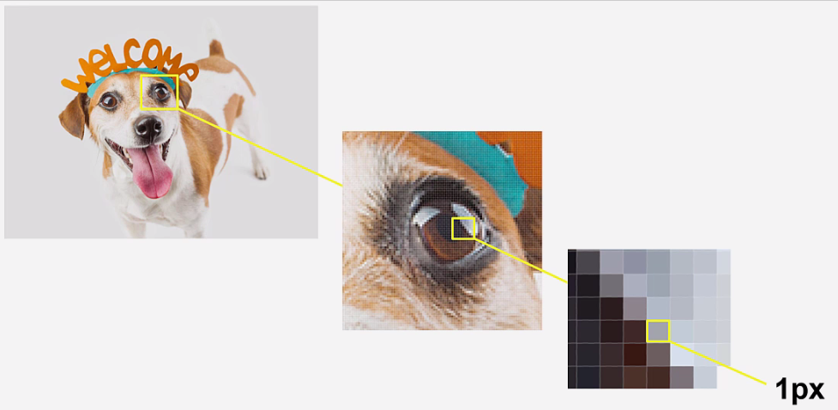
Right click – Copy Image Address
Right click – Save Image As
HTML5 - 10. Image
https://www.techartvn.com/academy

Slide 31
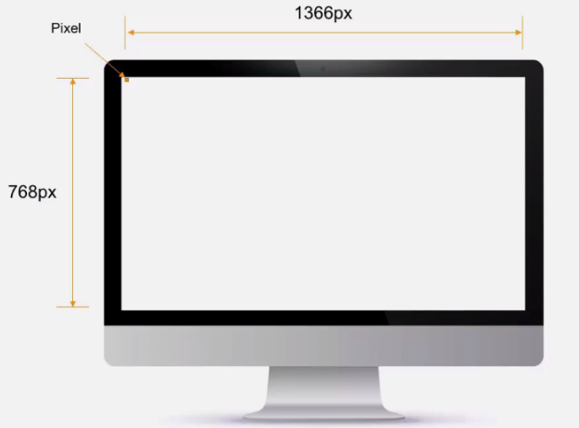
Right click – Copy Image Address
Right click – Save Image As
HTML5 - 10. Image
https://www.techartvn.com/academy

Slide 32
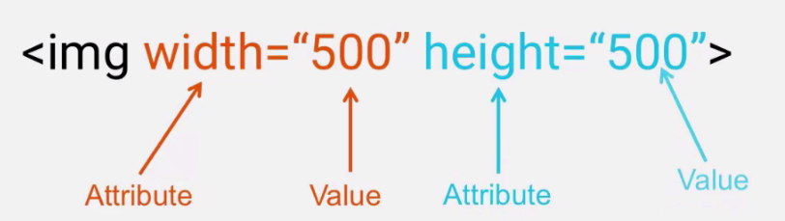
Right click – Copy Image Address
Right click – Save Image As
Default image Unit: px
HTML5 - 10. Image
https://www.techartvn.com/academy

Slide 33
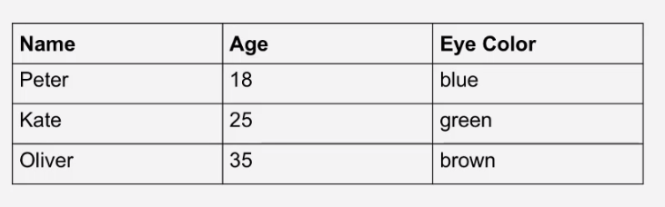
Create table.html file
HTML5 - 11. Tables
https://www.techartvn.com/academy

Slide 34
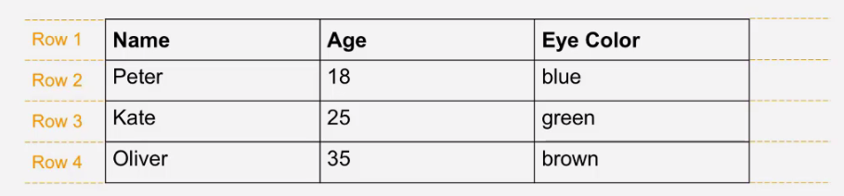
Create table.html file
HTML5 - 11. Tables
https://www.techartvn.com/academy

Slide 35
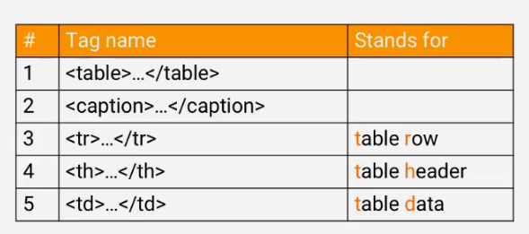
By default, the text in <th> elements are bold and centered.
By default, the text in <td> elements are regular and left-aligned
HTML5 - 11. Tables
https://www.techartvn.com/academy

Slide 36
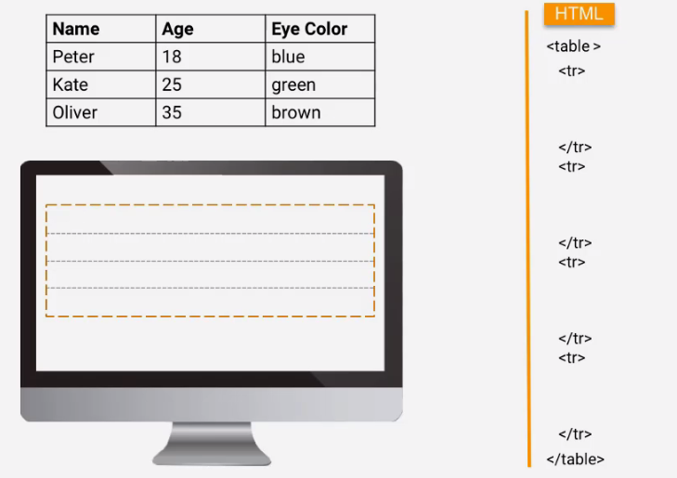
Create table.html file
HTML5 - 11. Tables
https://www.techartvn.com/academy

Slide 37
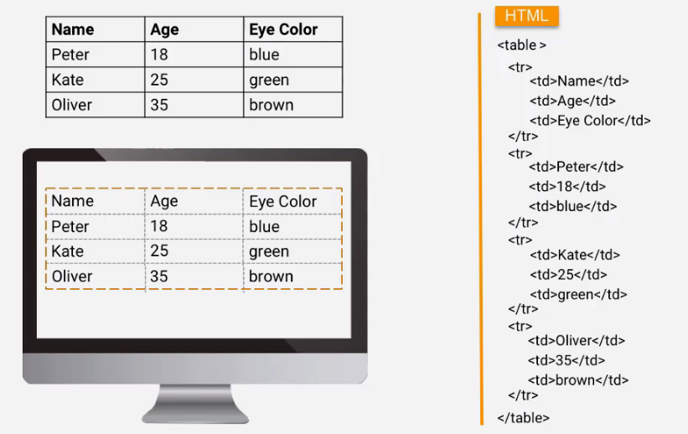
Create table.html file
HTML5 - 11. Tables
https://www.techartvn.com/academy

Slide 38
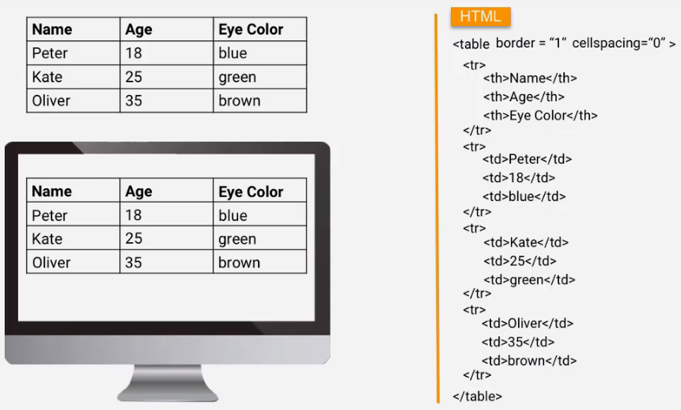
Add caption in front of first tr
https://css-tricks.com/useful-nth-child-recipies/
Table formatted
Border: 1px
Cellspace: 0
Cellpadding: 5
HTML5 - 11. Tables
https://www.techartvn.com/academy

Slide 39
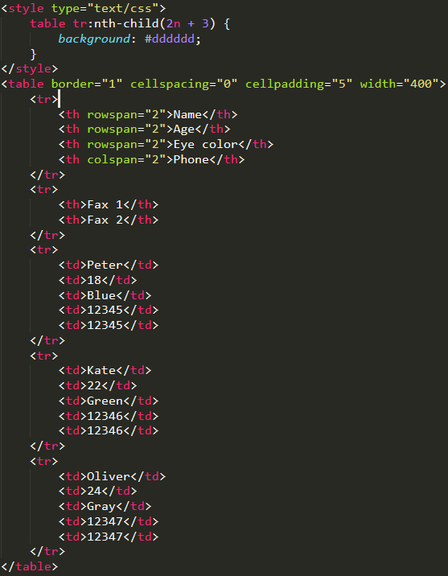
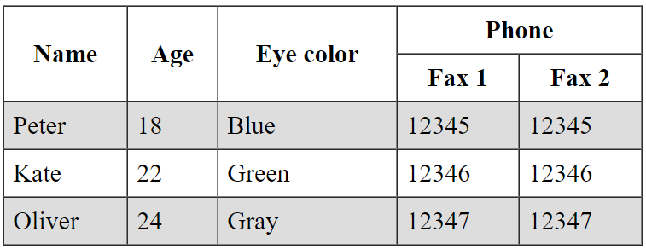
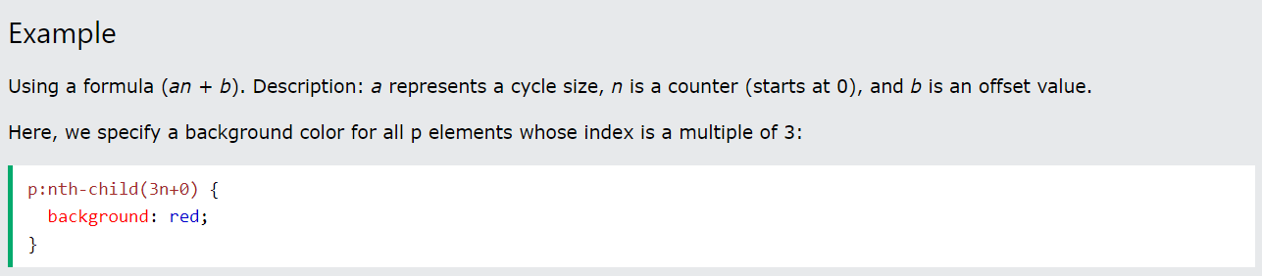
https://css-tricks.com/useful-nth-child-recipies/
colspan: Allows a single table cell to span the width of more than one cell or column
rowspan: Allows a single table cell to span the height of more than one cell or row
HTML5: <thead> <tbody> <tfoot>
HTML5 - 11. Tables
https://www.techartvn.com/academy

Slide 40
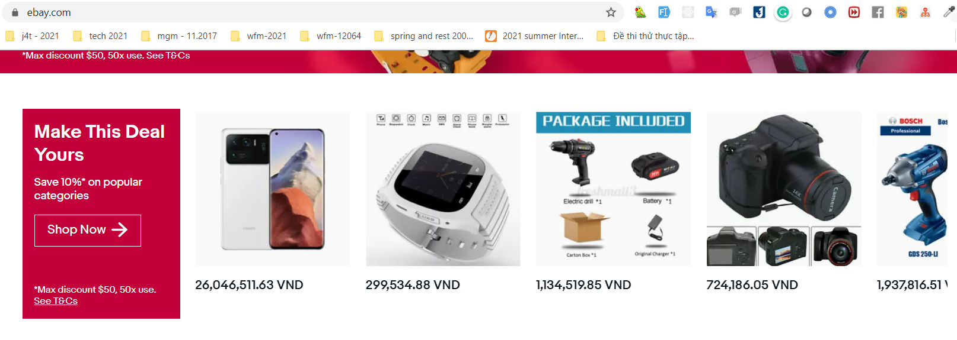
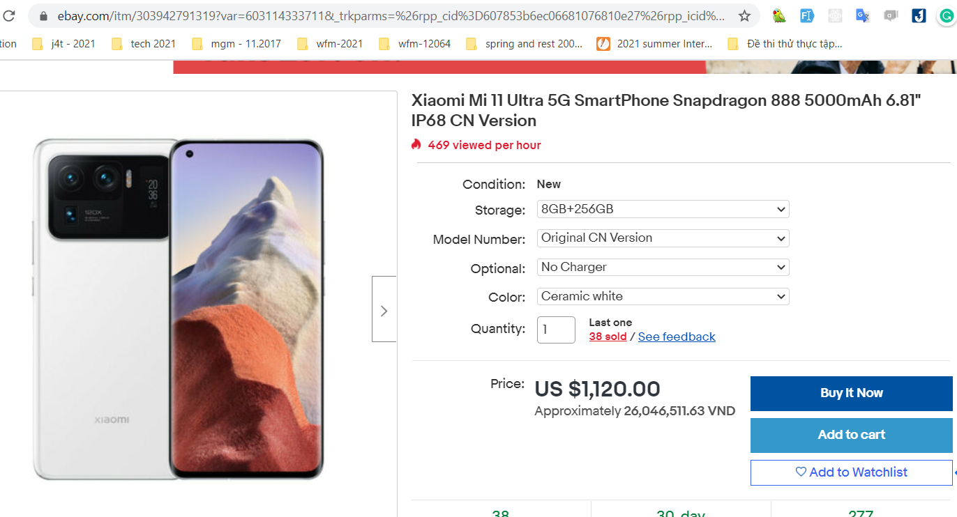
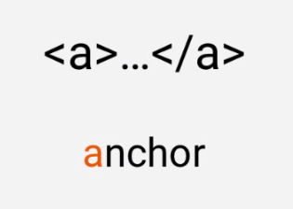

Hyper Link: Can be a text, image, component.
When we click it will jump to another webpage
Ref: https://www.ebay.com/
HTML5 - 12. Anchor tag
https://www.techartvn.com/academy

Slide 41

Hyper Link: Can be a text, image, component.
When we click it will jump to another webpage
Ref: https://www.ebay.com/
HTML5 - 12. Links
https://www.techartvn.com/academy

Slide 42



Hyper Link: Can be a text, image, component.
When we click it will jump to another webpage
Ref: https://www.ebay.com/
block: id
HTML5 - 12. Links
https://www.techartvn.com/academy

Slide 43

Page down: href=“path“
page-2: page-2.html
page-3: folder/page-3.html
page-4: folder/subfolder/page-4.html
HTML5 - 13. Relative Links
https://www.techartvn.com/academy

Slide 44

Page up: href=“path“
page-2: index.html
page-3: ../index.html
page-4: ../../index.html
HTML5 - 13. Relative Links
https://www.techartvn.com/academy

Slide 45

HTML5 – 14. UTF-8
https://www.techartvn.com/academy

Slide 46



Ref: https://unicode-table.com/
HTML5 – 14. UTF-8
https://www.techartvn.com/academy

Slide 47


Ref: https://unicode-table.com/en/#00A9
HTML5 – 14. UTF-8
https://www.techartvn.com/academy

Slide 48

Ref: https://unicode-table.com
Ref: https://www.w3schools.com/html/html_symbols.asp
HTML5 – 15. Special symbols
https://www.techartvn.com/academy

Slide 49


Ref: https://unicode-table.com
Ref: https://www.w3schools.com/html/html_symbols.asp
HTML5 – 15. Special symbols
https://www.techartvn.com/academy

Slide 50

HTML5 – 16. Multimedia
https://www.techartvn.com/academy

Slide 51

create mutlmedia.html
HTML5 – 16. Multimedia
https://www.techartvn.com/academy

Slide 52

Ref: https://developer.mozilla.org/en-US/docs/Web/HTML/Element/video
HTML5 – 16. Multimedia
https://www.techartvn.com/academy

Slide 53

Ref: https://www.w3schools.com/tags/tag_video.asp
HTML5 – 16. Multimedia
https://www.techartvn.com/academy

Slide 54

Ref: https://developer.mozilla.org/en-US/docs/Web/HTML/Element/audio
HTML5 – 16. Multimedia
https://www.techartvn.com/academy

Slide 55

Ref: https://developer.mozilla.org/en-US/docs/Web/HTML/Element/audio
HTML5 – 16. Multimedia
https://www.techartvn.com/academy
Notes:
<video src="tutorial.mp4" poster="thumnail.png" autoplay loop controls with="500"></video>
<iframe width="560" height="315" src="https://www.youtube-nocookie.com/embed/NJ0SPZ8NdsY" title="YouTube video player" frameborder="0" allow="accelerometer; autoplay; clipboard-write; encrypted-media; gyroscope; picture-in-picture" allowfullscreen></iframe>

Slide 56


Ref: https://developer.mozilla.org/en-US/docs/Web/HTML/Element/audio
HTML5 – IFrame
https://www.techartvn.com/academy
Notes:
<video src="tutorial.mp4" poster="thumnail.png" autoplay loop controls with="500"></video>
<iframe width="560" height="315" src="https://www.youtube-nocookie.com/embed/NJ0SPZ8NdsY" title="YouTube video player" frameborder="0" allow="accelerometer; autoplay; clipboard-write; encrypted-media; gyroscope; picture-in-picture" allowfullscreen></iframe>

Slide 57

Ref: https://developer.mozilla.org/en-US/docs/Web/HTML/Element/audio
HTML5 – IFrame
https://www.techartvn.com/academy

Slide 58



HTML5 – 17. Division
https://www.techartvn.com/academy
Notes:
Sematic tag

Slide 59

HTML5 – 17. Division
https://www.techartvn.com/academy

Slide 60


HTML5 – 18. Span
https://www.techartvn.com/academy
Notes:
Container to wrap the text

Slide 61

Ref: https://signup.ebay.com/pa/crte
HTML5 – 20. Form
https://www.techartvn.com/academy

Slide 62

Ref: https://signup.ebay.com/pa/crte
HTML5 – 20. Form
https://www.techartvn.com/academy

Slide 63

HTML5 – 20. Form
https://www.techartvn.com/academy

Slide 64

HTML5 – 20. Form
https://www.techartvn.com/academy

Slide 65

https://developer.mozilla.org/en-US/docs/Learn/Forms/HTML5_input_types
HTML5 – 20. Form
https://www.techartvn.com/academy

Slide 66

HTML5 – 20. Form
https://www.techartvn.com/academy

Slide 67

HTML5 – 20. Form
https://www.techartvn.com/academy

Slide 68


format code: Edit > Line > Reindent
copy line: Ctrl Shift D
delete row: Ctrl X
HTML5 - Title
https://www.techartvn.com/academy
Notes:
https://cdnjs.com/libraries/font-awesome font awesome cdn
https://wireframepro.mockflow.com/

